Slide 1
Lab 7
Bahaa Khaled Mohamed
21010383

Slide 2
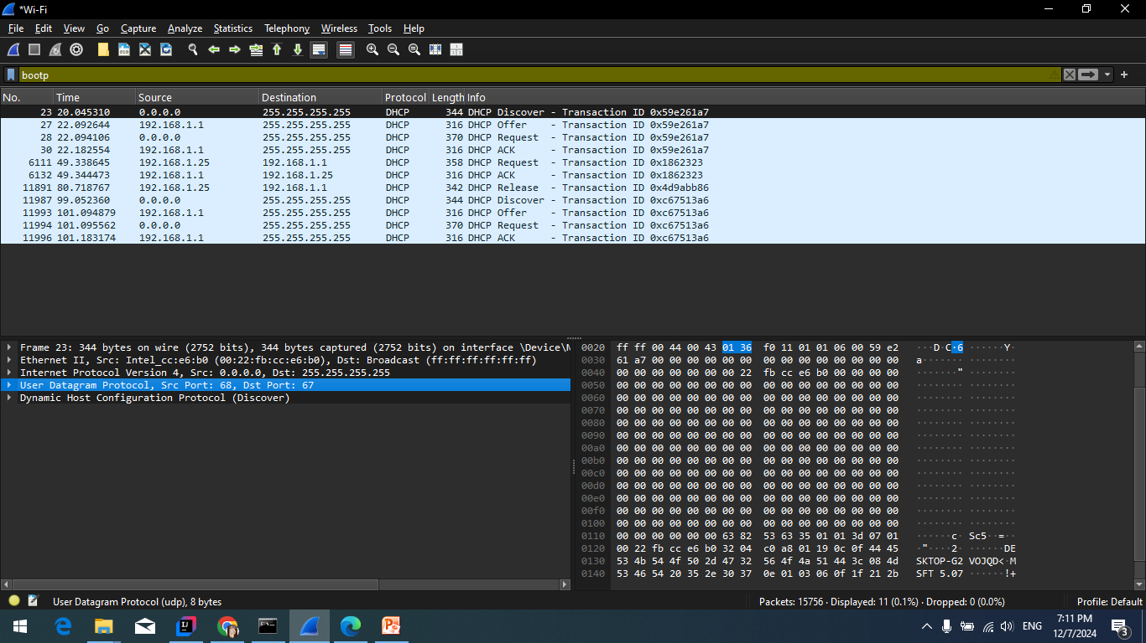
Q1
DHCP is sent over UDP.

Slide 3
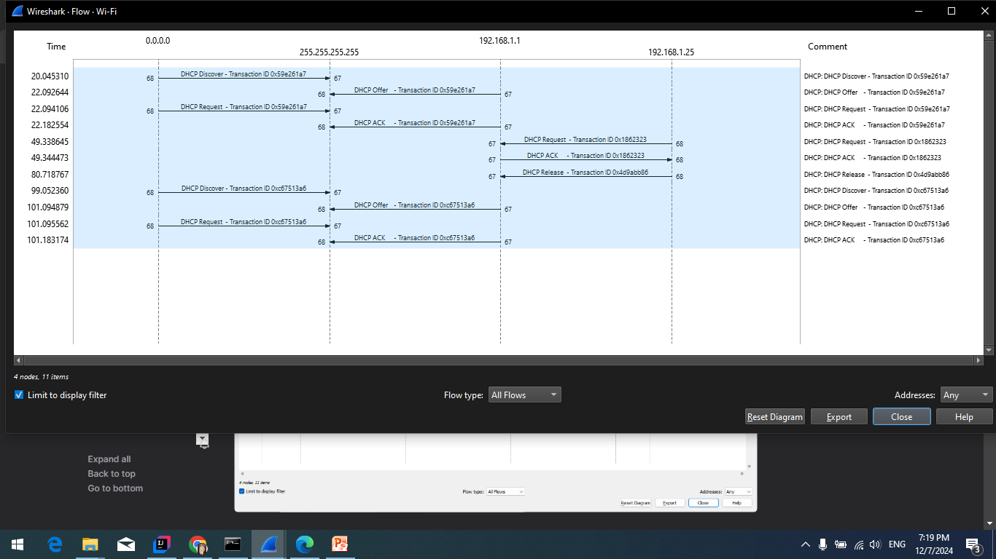
Q2

Slide 4
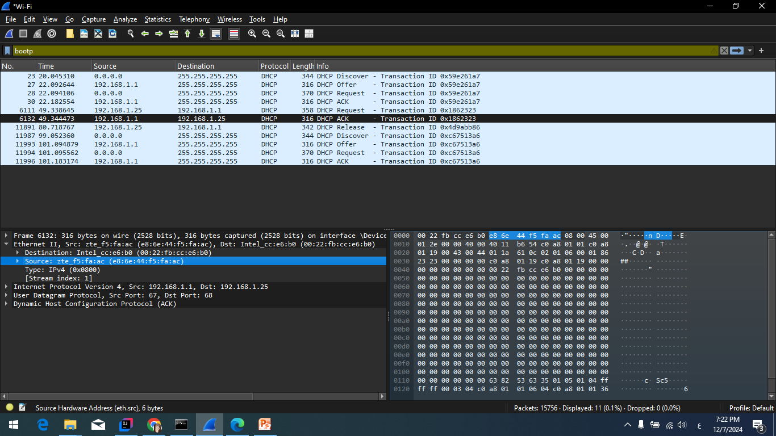
Q3

Slide 5
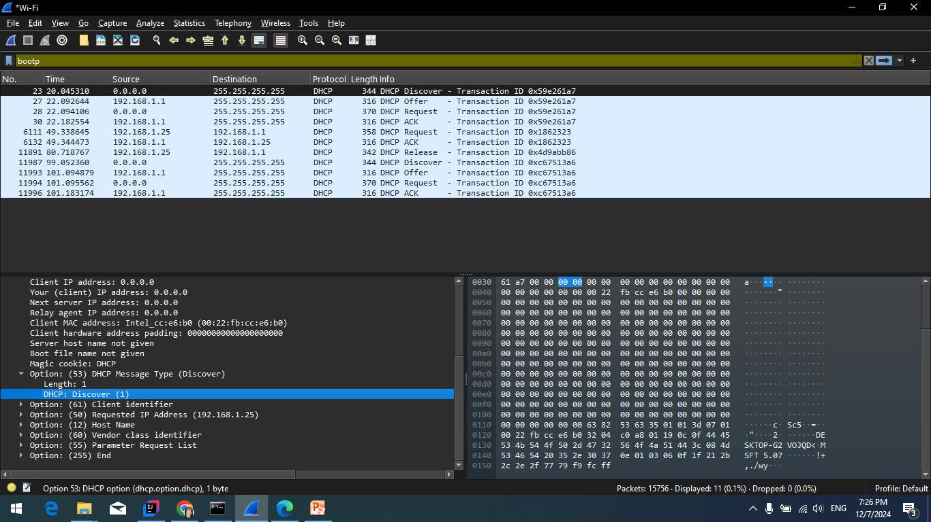
Q4

Slide 6
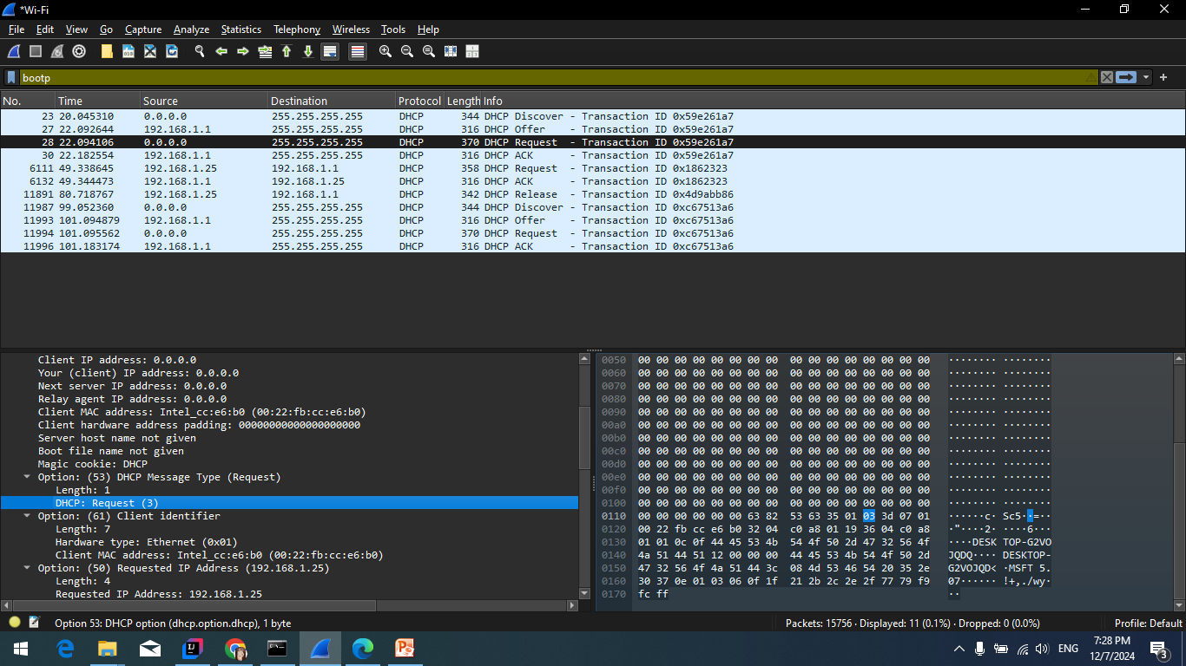
Q4

Slide 7
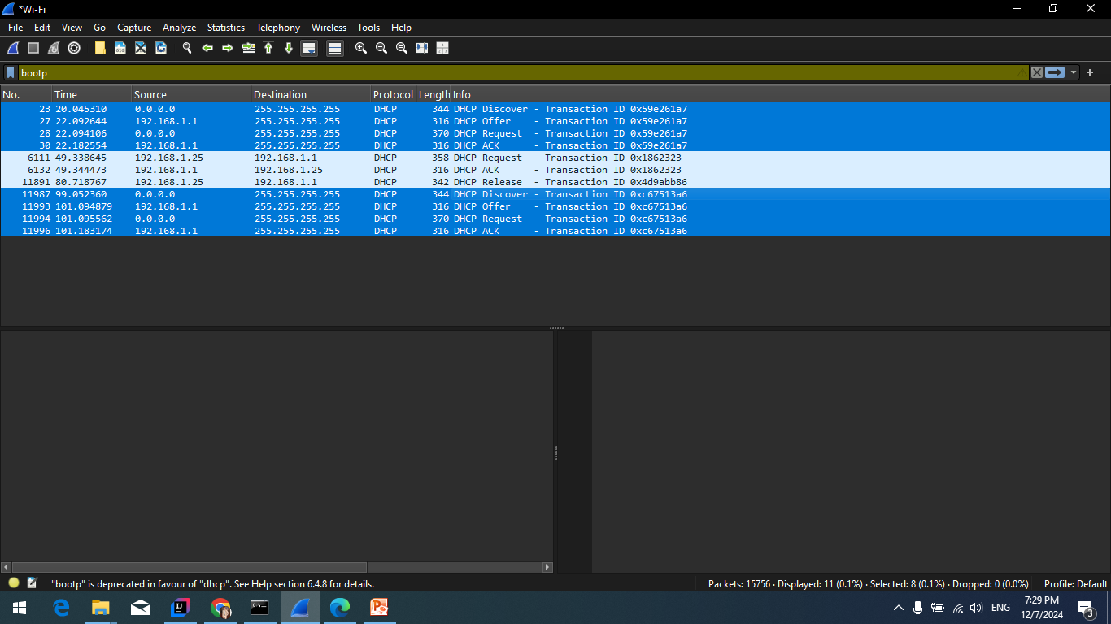
Q5

Slide 8
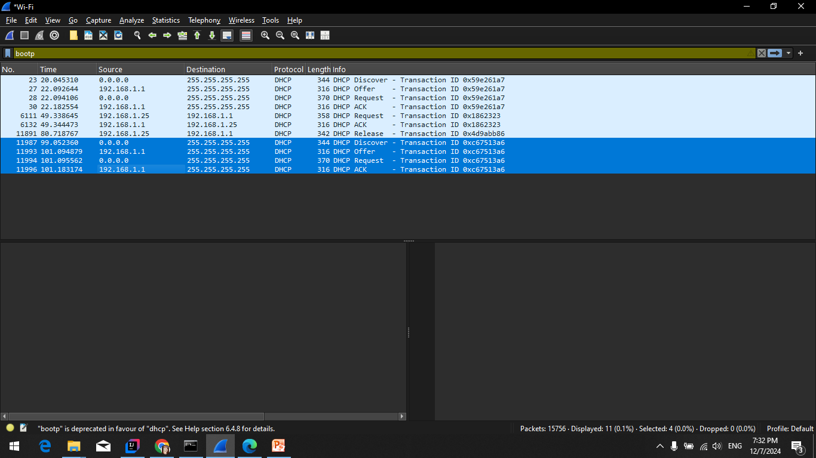
Q6

Slide 9
Q7
192.168.1.1

Slide 10
Q8
255.255.255.255

Slide 11
Q10
The router line shows where the client should send messages by default
The subnet mask line shows the client which subnet mask to use

Slide 12
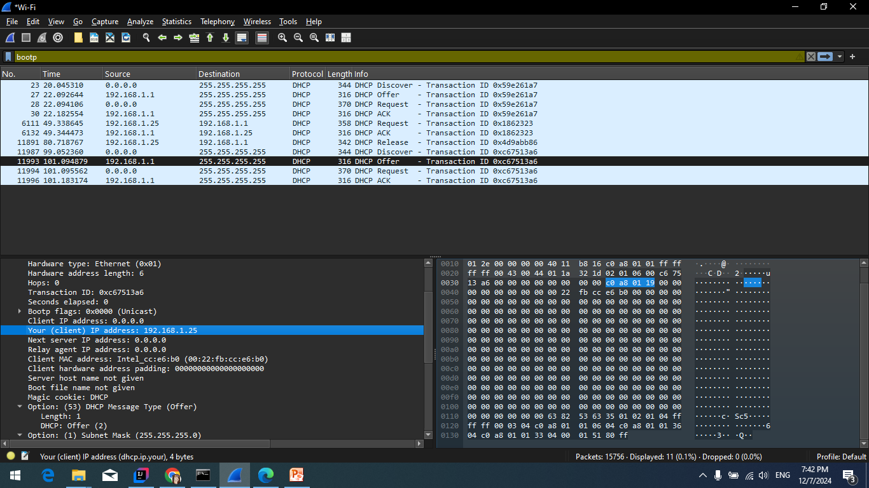
Q11

Slide 13
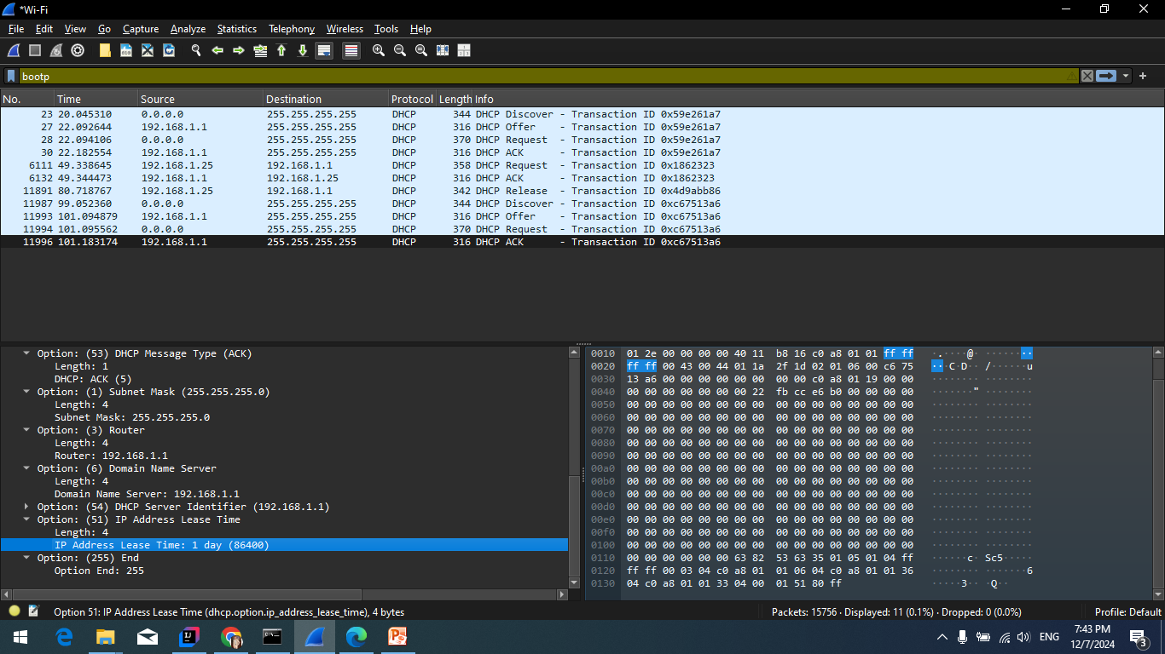
Q12

Slide 14
Q13
DHCP Release Message is the request to release the IP back to the DHCP Server. There is no ACK for this

Slide 15
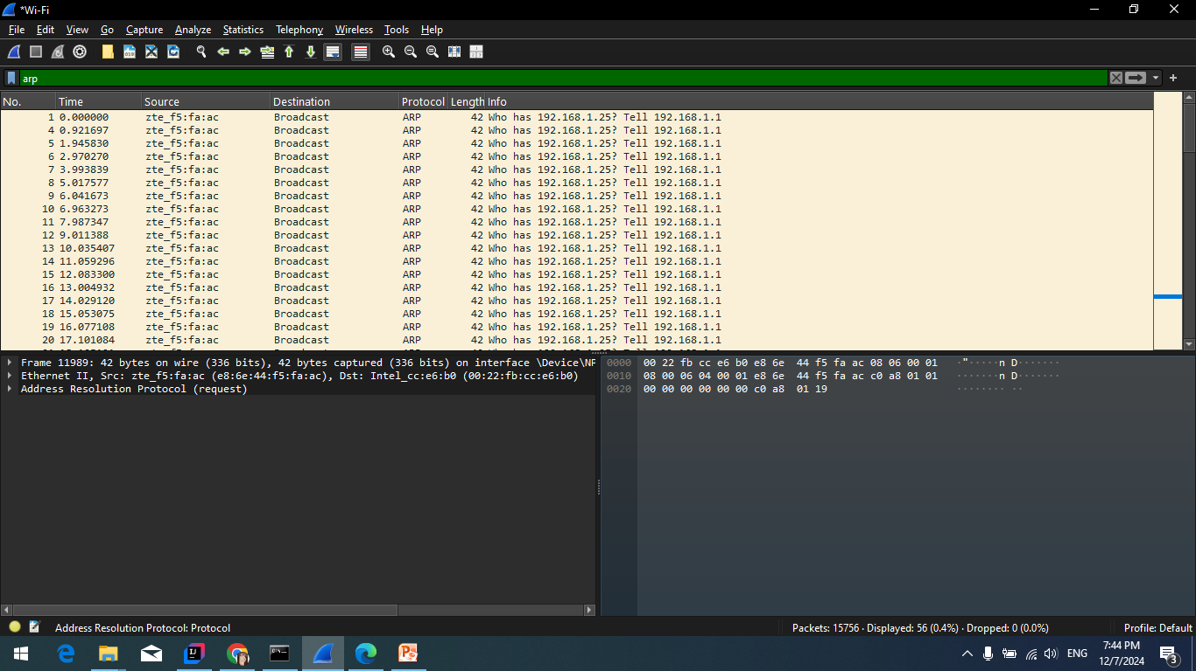
Q14

